Slide 1
Batch Record

Slide 2
What is Batch Record?
A batch record (BR) is the documented execution detail of the manufacturing Process of a regulated product, including authors, steps, materials, and equipment. Batch records are required for the manufacture of drugs and medical devices in life science manufacturing.

Slide 3

Nicardipine HCl Injection

Slide 4
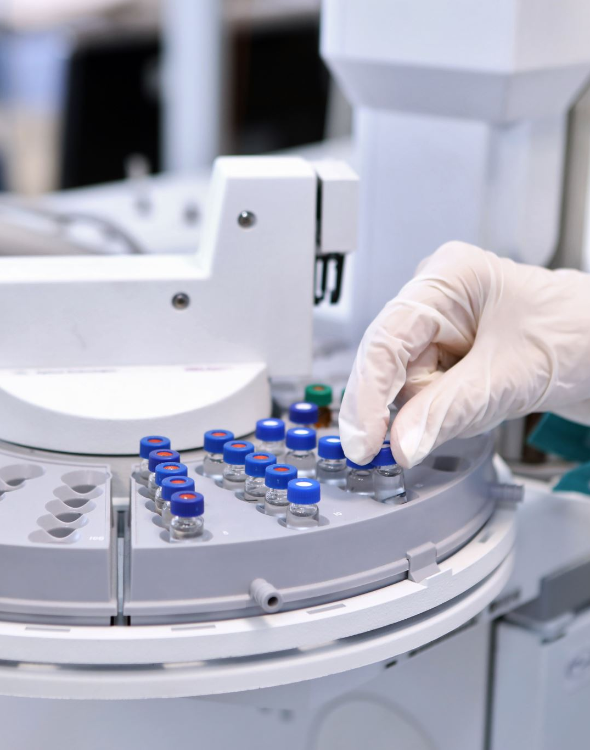
Sections in Nicardipine Hcl injection
VIAL WASHING AND DEPYORGENATION
UTENSILS AND COMPONENET PREPARATION
API DATA SECTION
FINISHED PRODUCT COA
COMPOUNDING
INPROCESS TESING
INPROCESS MICROBIOLOGY TESTING
FILTRATION
FILLING
CAPPING
TERMINAL STERILIZATION
INSPECTION
APPLICABLE REPORTS

Slide 5

Compounding

Slide 6
What is Compounding?
Drug Compounding is often regarded as the process of combining, mixing or altering ingredients to create a medication tailored to the needs of an individual patient.

Slide 7
Spread sheet of Compounding
Compounding

Slide 8

Thank You

